Slide 1
Advanced Databases Lecture 12: Graph Databases
Dr. Pierpaolo Dondio,
DT228 - ASD

Slide 2
Why NOSQL?
Notes:
The following trends make it increasingly difficult to perform analytics with relational databases
And more importantly, the following trends make it near to impossible to perform these analytics within the click stream. (i.e. on-the-fly analysis and results)

Slide 3
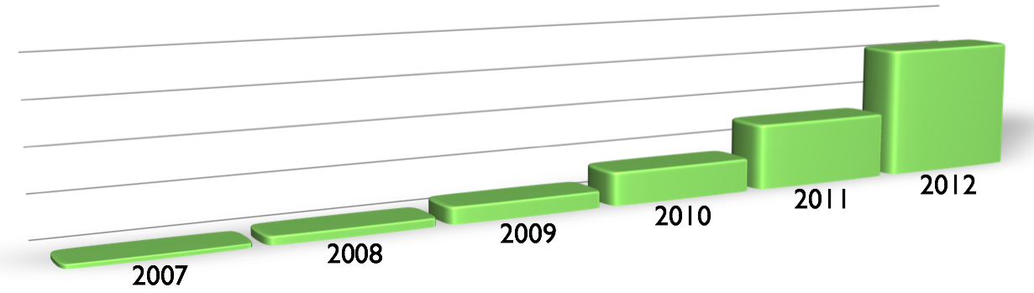
Driving Trends - Data Size
Data size is increasing exponentially year after year
Notes:
Creating more data year after year.
Storing and process this data is becoming increasing difficult for the relational databases

Slide 4
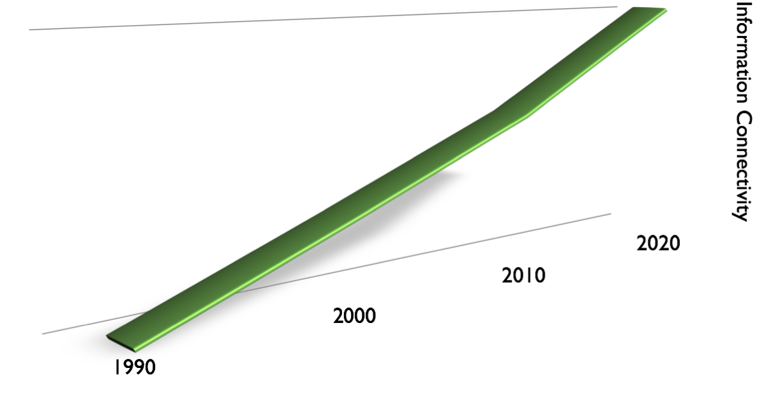
Driving Trends - Connectivity of Data
GGG
Hypertext
Ontologies
Hypertext
RDFa
Hypertext
Folksonomies
Hypertext
Tagging
Hypertext
Wikis
Hypertext
UGC
Hypertext
Blogs
Feeds
Hypertext
“Web 3.0”
Hypertext
Web 2.0
Flat Docs
Web 1.0
.0
Notes:
Data is being coming more connected. As the volume of data grows, so does the complexity.
- UGC: User-generated Content
- Folksonomies: collaborative tagging, social classification, social indexing, social tagging
- RDFa (Resource Description Framework with attributes): used to carry metadata in XML
- Ontologies: domain specific objects
- GGG (Giant Global Graph): Every piece of information is semantically connected

Slide 5
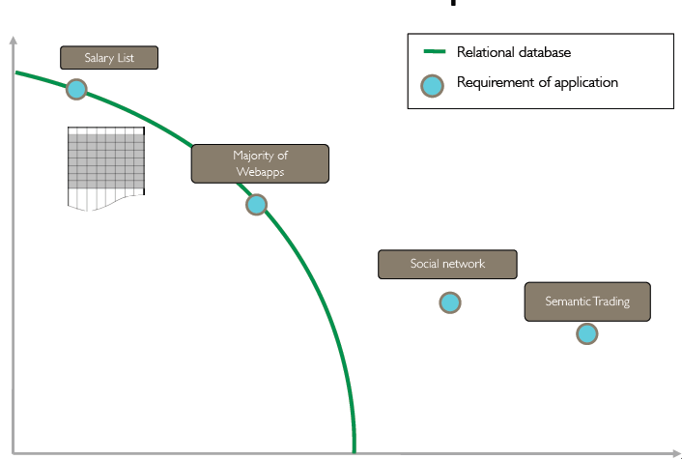
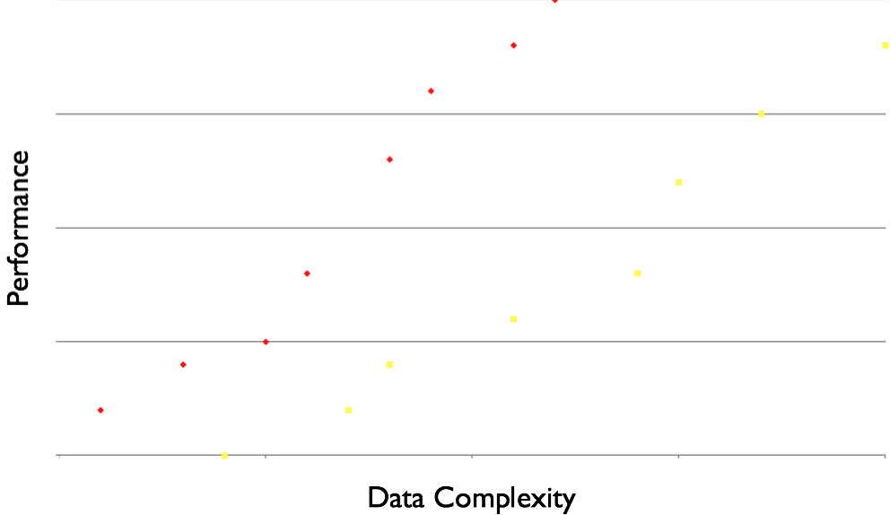
RDBMS Performance Curve
Notes:
Before we start talking about NOSQL let’s give relational databases a little credit.
Relational database are still great for tabular data
Performance degrades as data becomes more deeply connected and voluminous
I’m not telling to you shy away from relational database, but in this polyglot persistence world different use cases require different ways of storing and process today’s data

Slide 6








NOSQL Database Types
Key-Value
Column Family
Document
Graph
Notes:
4 types of databases in the NOSQL universe:
K-V Stores
Column Family Store
Document Databases
Graph Databases
Who here has worked with NOSQL stores before?
For the people that raised their hand how many used...
KV Stores?
Column Family?
Document DBs?
Graph DBs?
If you raised your hand for Graph DBs, then pat yourself on the back b/c that’s where I spend most of my time.

Slide 7
NoSQL databases
Four classes of NoSQL databases
Key-value store
Amazon’s Simple DB
Column-family or big table databases
Google’s Big Table
Apache Cassandra database
Document-oriented
MongoDB
Graph Databases
Neo4j

Slide 8
Document-oriented Databases
Data Model
Collection of documents
Document is a key-value collection
Index-centric
Examples
MongoDB, CouchDB, Lotus Notes?
Notes:
These are becoming more popular today
Contains documents and a document is simply a key-value collection
Usually have great index support!!!
Is there anyone out there thats still using Notes? Please say no. Notes was actually one of the early Document Databases. I suppose you can say that’s one thing that isn’t completely terrible from the Lotus products.

Slide 9
Document-oriented Databases: Strengths and Weaknesses
Strengths
Simple, but powerful data model
Good scalability
Weaknesses
Does not handle interconnected data well
Querying is limited to keys and indexes
MapReduce for large queries
Notes:
Again we see this trend where all of these NOSQL stores do not handle interconnected data well. I wonder where this is going

Slide 10
Graph Databases
Data Model
Nodes with properties
Named relationships with properties
Examples
Neo4j, Sones GraphDB, OrientDB, InfiniteGraph, AllegroGraph
Notes:
Finally we have graph databases. My little section of the NOSQL universe

Slide 11
Graph Databases: Strengths and Weaknesses
Strengths
Extremely powerful data model
Performant when querying interconnected data
Easily to query
Weaknesses
Sharding
Not everything is a graph
Notes:
Has the richest data model of all of the NOSQL types
Graphs are mutable which makes it extremely hard to shard because graphs are naturally mutable. You can shard based on domains but you would need to reduce the chances of creating relationships between the two graphs.

Slide 12
Typical Use Cases for Graph Databases
Recommendations
Business Intelligence
Social Computing
Geospatial
Genealogy
Time Series Data
Web Analytics
Fraud Detection
Notes:
Indexing relational DBs: Some people classify SOLR as a NOSQL store

Slide 13
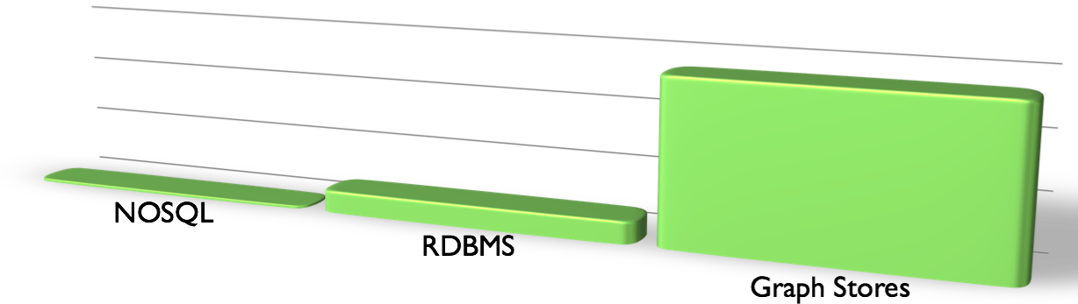
Maturity of Data Models
Most NOSQL: ~6 years
Relational: 42 years
Graph Theory: 276 years
Notes:
The relational model is quite mature, but Graph theory is much older.
So when you boss says that you can’t use Graph database because they’re not mature enough, just tell him that he needs to check his facts.

Slide 14
Graph Data Model
Event
Person
City

Slide 15
Graph Data Model
Event
Rated
Person
Is Attending
Hosted In
Is Located In
City

Slide 16
Graph Data Model
Event
name:DevCon
Rated
score: 11 out of 10
comment: Amazing!!!
Person
firstName:kyle
lastName:adams
Is Attending
Hosted In
Is Located In
City
name:San Jose
country:USA

Slide 17
Neo4j

Slide 18


Introducing Neo4j
Introduced in 2010
Developed by Neo Technologies
Most Popular Graph Database
Open source
Java-based
NoSQL Graph Database

Slide 19
Graph Database (cont.)
Nodes represent entities
Edges represent relationships
Connections between data are explored
Faster for associative data sets
Intuitive
Optimal for searching social network data

Slide 20
Graph Databases
Database that uses graph structures with nodes, edges and properties to store data
Provides index-free adjacency
Every node is a pointer to its adjacent element
Edges hold most of the important information and connect
nodes to other nodes
nodes to properties
Notes:
TODO: Add pictures here

Slide 21
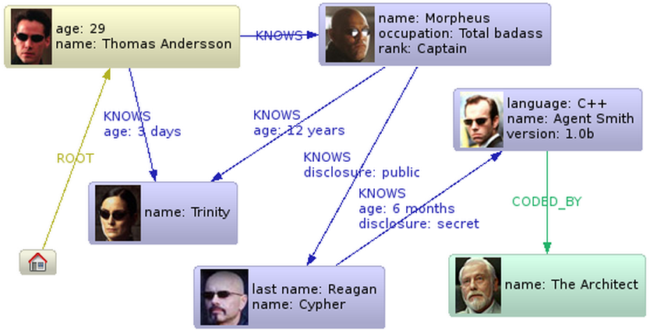
Graph Database
Neo4j is a graph database
Database full of linked nodes
Stores data as nodes and relationships

Slide 22
Advantage of Graph Databases
When there are relationships that you want to analyze Graph databases become a very nice fit because of the data structure
Graph databases are very fast for associative data sets
Like social networks
Map more directly to object oriented applications
Object classification and Parent->Child relationships

Slide 23
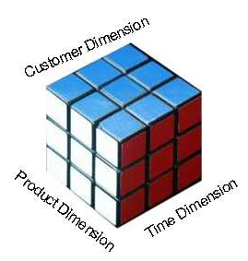
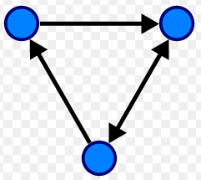
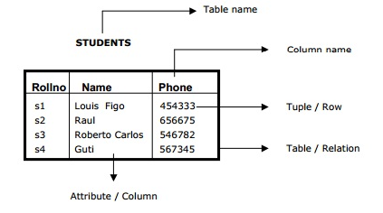
Disadvantages
If data is just tabular with not much relationship between the data, graph databases do not fare well
OLAP support for graph databases is not well developed
Lots of research happening in this area
Ease of aggregation

Slide 24
Salient features of Neo4j
Neo4j is schema free – Data does not have to adhere to any convention
ACID – atomic, consistent, isolated and durable for logical units of work
Easy to get started and use
Well documented and large developer community
Support for wide variety of languages
Java, Python, Perl, Scala, Cypher, etc
(Mistry, Deep, 2013)

Slide 25
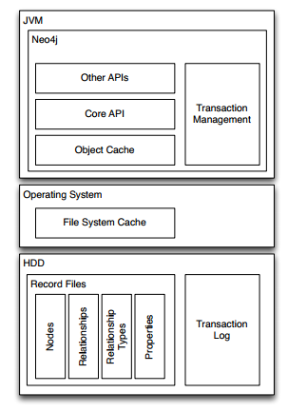
Neo4j Software Architecture
(Bachman, 2013, p.11)

Slide 26
More Reasons Why Neo4j is Great
High performance graph operations
Traverse 1,000,000+ relationships/sec on commodity hardware
32 billion nodes & relationships per Neo4j instance
64 billion properties per Neo4j instance
Small footprint
Standalone server is ~65mb

Slide 27

Social Network Performance (traversals)
Why a Graph Database? MySQL vs Neo4j
Notes:
This brings us to an experiment in which Neo Technology has benchmarked performance of MySQL and Neo4j in a social graph

Slide 28
Social Network Performance
The Experiment: Round 1
First rule of fight club:
Run a friends of friends query
Second rule of fight club:
1,000 Users
Third rule of fight club:
Average of 50 friends per user
Fourth rule of fight club:
Limit the depth of 5
Fifth rule of fight club:
Intel i7 commodity laptop w/8GB RAM
Notes:
We want to run a query that find all of the friends of Kyle. then the friends of his friends and so on.

Slide 29
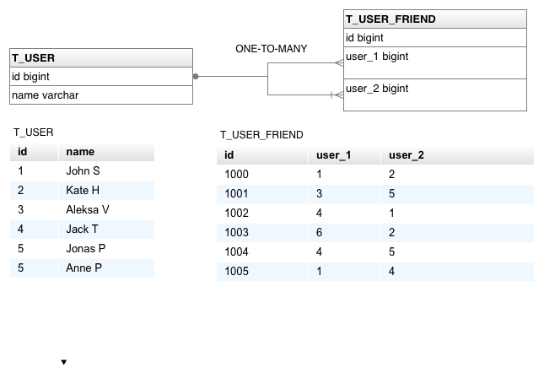
Social Network Performance
RDBMS Schema
Notes:
We have a table that stores all users and another table that stores primary and foreign keys that map the friendships

Slide 30
Social Network Performance
SQL: Friends of friends at depth 3
SELECT distinct uf3.*
FROM t_user_friend uf1
INNER JOIN t_user_friend uf2 on uf1.user_1 = uf2.user_2
INNER JOIN t_user_friend uf3 on uf2.user_1 = uf3.user_2
WHERE uf1.user_1 = user_id
Notes:
This is an example of the SQL query used as depth 3. find friends of friends of friends of a particular user

Slide 31
Social Network Performance
MySQL Results: Round 1- 1,000 Users
Depth | Execution Time (sec) | Records Returned
2 | 0.028 | ~900
3 | 0.213 | ~999
4 | 10.273 | ~999
5 | 92,613.150 | ~999
Notes:
find friends of friends of friends of the user
We see a dramatic decrease in performance the more inner joins we add to the query.

Slide 32
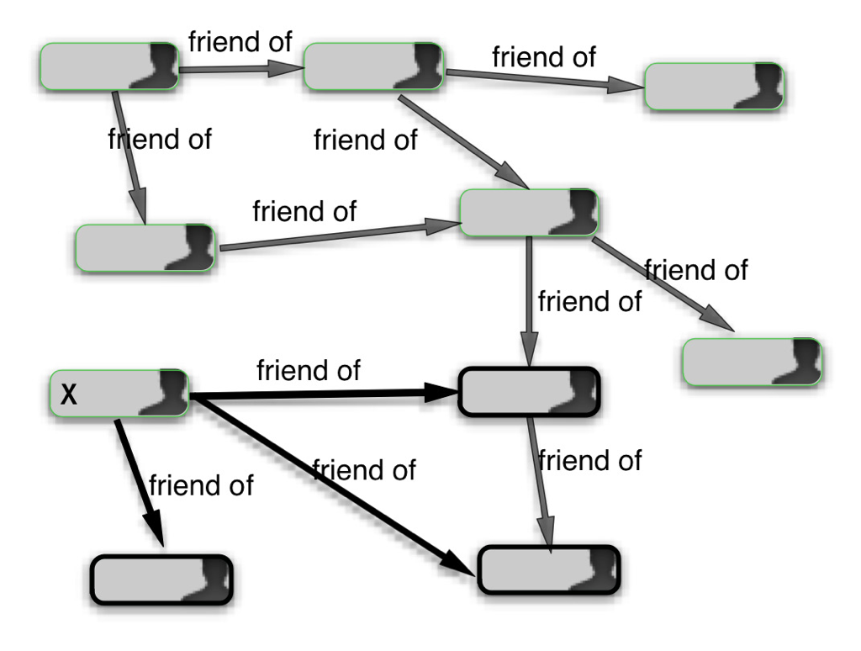
Social Network Performance
Social Graph
Notes:
For Neo4j the social network is a typical graph

Slide 33
Social Network Performance
Neo4j Results: Round 1- 1,000 Users
Depth | Execution Time (sec) | Records Returned
2 | 0.04 | ~900
3 | 0.06 | ~999
4 | 0.07 | ~999
5 | 0.07 | ~999
Notes:
So let look at Neo4j’s performance
We see that performance is relatively unaffected as we increase the depth of traversal

Slide 34
Social Network Performance
The Experiment: Round 2
First rule of fight club:
Run a friends of friends query
Second rule of fight club:
1,000,000 Users
Third rule of fight club:
Average of 50 friends per user
Fourth rule of fight club:
Limit the depth of 5
Fifth rule of fight club:
Intel i7 commodity laptop w/8GB RAM
Notes:
We perform the same queries but we increase the total amount of users to 1 million.
In MySQL we will have 1,000,000 records in t_user table, and approximately 1,000,000 X
50 = 50,000,000 records in t_user_friend table.

Slide 35
Social Network Performance
MySQL Results: Round 1- 1,000,000 Users
Depth | Execution Time (sec) | Records Returned
2 | 0.016 | ~2,500
3 | 30.267 | ~125,000
4 | 1,543.505 | ~600,00
5 | Did not finish after an hour | N/A
Notes:
1,543.505 ~ 25 minutes
Depth five didn’t finish after running for an hour

Slide 36
Social Network Performance
Neo4j Results: Round 1- 1,00,000 Users
Depth | Execution Time (sec) | Records Returned
2 | 0.010 | ~2,500
3 | 0.168 | ~110,000
4 | 1.359 | ~600,000
5 | 2.132 | ~800,000
Notes:
For Neo4j we have a linear increase in execution time.

Slide 37
Social Network Performance
Why is RDBMS performance horrible?
To find all friends on depth 5,MySQL will create Cartesian product on t_user_friend table 5 times
Resulting in 50,000^5 records return
All except 1,000 are discarded
Neo4j will simply traverse through the nodes in the database until there are no more nodes in which to traverse
Notes:
To find all friends on depth 5, MySQL will create Cartesian product on t_user_friend
table 5 times, resulting in 50,0005 records, out of which all but 1,000 are discarded. Neo4j,
on the other hand, will simply visit nodes in the database, and when there is no more nodes
to visit, it will stop the traversal.

Slide 38
Cypher
Query Language for Neo4j
Easy to formulate queries based on relationships
Many features stem from improving on pain points with SQL such as join tables
(Hunger, Michael 2013)

Slide 39
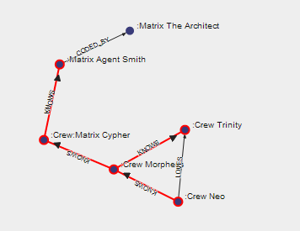
Cypher

Slide 40

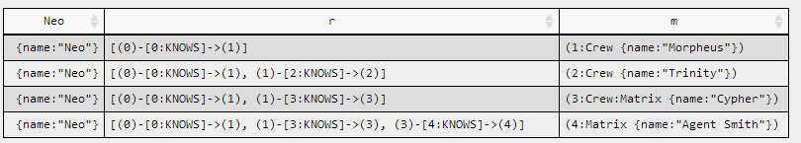
Cypher

Slide 41

Application Domains

Slide 42
Conclusion
Key questions to ask yourself
Is my data going to have a lot of relationships?
What sort of questions would I like to ask my database?
Neo4j is a fantastic Graph Database

Slide 43
Demo
Create nodes with properties
Match nodes
Create relationships between nodes
Traverse the graph
Show paths
Accumulators

Slide 44
Create nodes
Create nodes
CREATE (e1:Student { name: "Emil", from: "Sweden", age: 29 })
CREATE (e2:Student { name: "Paul", from: "Sweden", age: 29, gender: “m” })
CREATE (s1:Subject { name: “Maths", lecturer: “Pierpaolo", age: 29 })

Slide 45
Match Nodes
Match is used to select nodes. A match query must be ended by a Return statement.
MATCH (e:Student) return e;
MATCH (e:Student {age < 25}) return e;
MATCH (e:Student {name: “Emil”});

Slide 46
Create Relationship
Nodes are connected by relationships. Relationship can have nodes as well.
MATCH (e:Student {name:'Emil'}), (r:Student {name:'Joe'}) CREATE (e)-[:FRIEND_OF]->(r)
MATCH (s:Student {name: “Emil”}),(s:Subject {name: “math”})
CREATE (s)-[r:MARK{date:"12/12/2014",mark:55}]->(s) RETURN r

Slide 47
Navigate the graph
Neo4j can easily navigate the graph
MATCH (e:Student {name:"Emil"})-[:FRIEND_OF*1..3]-(e2:Student)
RETURN e2
MATCH (e:Student {name:"Emil"})-[:FRIEND_OF*1..3]-(e2:Student)
RETURN e2.from, COUNT(e2.from) as numfriends
MATCH (e:Student {name:"Alice"})
MATCH path = shortestPath( (e)-[:FRIEND_OF*..5]-(m:Student {name:"Mary"}) )
RETURN path

Slide 48
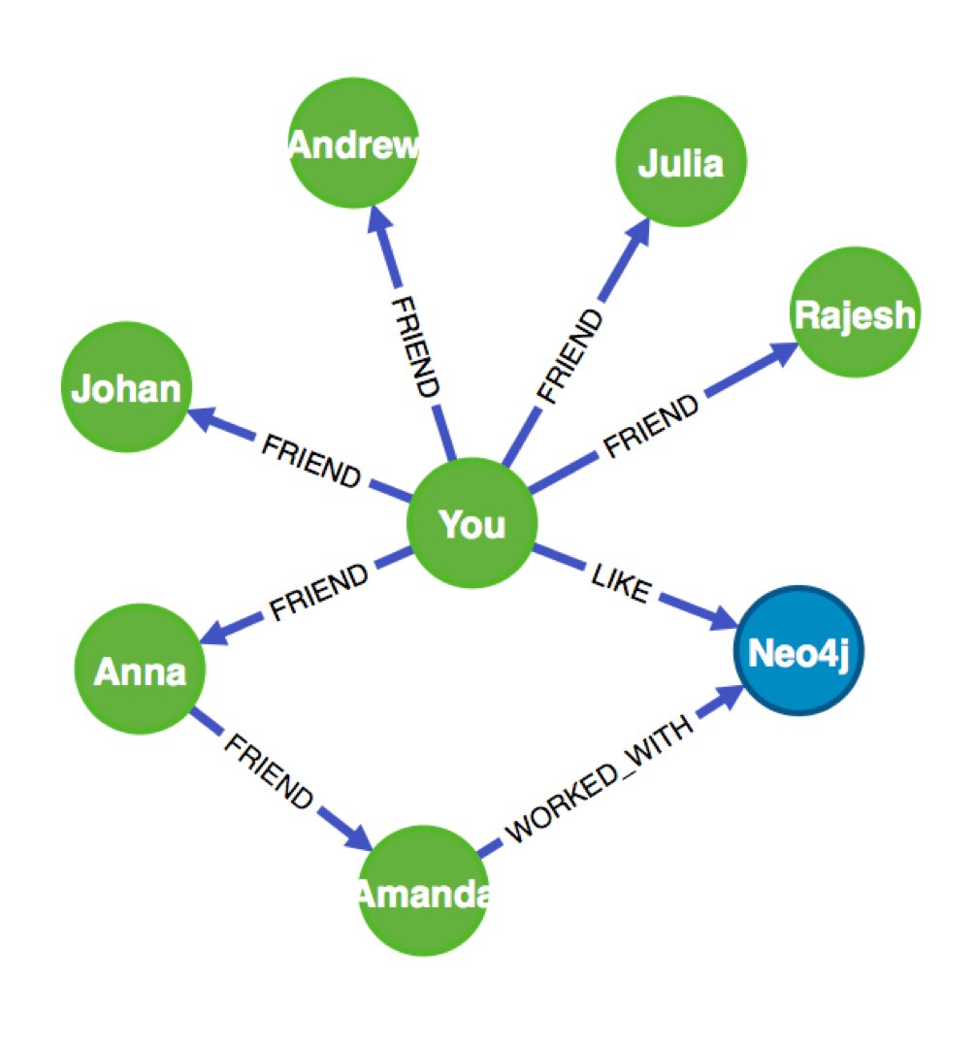
Navigate the graph – mixing properties
MATCH (you {name:"You"})
MATCH (expert)-[:WORKED_WITH]->(db:Database {name:"Neo4j"})
MATCH path = shortestPath( (you)-[:FRIEND*..5]-(expert) )
RETURN db,expert,path

Slide 49
Reduce function
It will go through a list, run an expression on every element, storing the partial result in the accumulator.
Syntax: reduce( accumulator = initial, variable IN list | expression )
Arguments:
accumulator: A variable that will hold the result and the partial results as the list is iterated
initial: An expression that runs once to give a starting value to the accumulator
list: An expression that returns a list
expression: This expression will run once per value in the list, and produces the result value.
MATCH (e:Student {name:"Alice"})
MATCH path = shortestPath( (e)-[:FRIEND_OF*..5]-(m:Student {name:"Mary"}) )
RETURN
reduce(tot = 0, n IN nodes(path) | tot + path.age) as tot_age

